Slide 1
Temporal Trends and Survival Determinants in Capnography: A Machine Learning Study
Banu Priya Raya Krishnamoorthy
Graduate Program in Computer Science and Engineering
The Ohio State University, 2024
Dr. Rajiv Ramnath, Advisor
Dr. Michelle Nassal, Principal Investigator
Dr. Emre Ertin, Project Mentor
Notes:
Good morning, everyone. Thank you for being here today.
I’m excited to present my Master’s project, titled 'Temporal Trends and Survival Determinants in Capnography: A Machine Learning Study.'
This work focuses on leveraging machine learning to analyze end-tidal carbon dioxide or EtCO₂— a critical physiological marker—during cardiac resuscitation.
Over the course of this presentation, I’ll walk you through the data, methodologies, and results, highlighting the potential of this work to transform patient outcomes in emergency medicine. Let’s dive in.

Slide 2
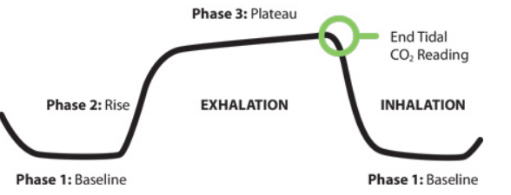

End Tidal Capnography & ROSC
End-tidal capnography waveform is a simple graphic measurement of how much CO₂ a person is exhaling.
The measurement at the end of the tide of respiration, the peak measurement at the very end of phase 3, is the EtCO₂ reading.
This measurement is widely used in emergency and critical care to assess ventilation, perfusion, and the effectiveness of resuscitation.
ROSC stands for “Return of Spontaneous Circulation’’, it refers to the moment when a heart's rhythm resume and blood begins to flow through the body after cardiac arrest.
https://www.jems.com/patient-care/airway-respiratory/how-to-read-and-interpret-end-tidal-capnography-waveforms/
Notes:
An end-tidal capnography waveform is a simple graphic measurement of how much CO₂ a person is exhaling.
The normal end-tidal capnography wave form is basically a rounded rectangle.² When a person is breathing out CO₂, the graph goes up. When a person is breathing in, it goes back down.
The normal waveform has three distinct phases:
Phase 1 is inhalation, where CO₂ levels are at baseline, typically zero, since no CO₂ is exhaled during this phase.
Phase 2 marks the start of exhalation, as CO₂ from the alveoli travels through the airways, causing a sharp rise in the graph.
Phase 3 represents the plateau phase, where the sensor detects CO₂-rich gas from the alveoli. The peak at the end of this phase gives us the EtCO₂ reading. After this, the cycle restarts as the person inhales, bringing the graph back to baseline.
ROSC stands for "Return of Spontaneous Circulation" and refers to the moment when a heart's rhythm resumes and blood begins to flow through the body after cardiac arrest

Slide 3
Problem Statement
Every year, half a million Americans suffer from out-of-hospital cardiac arrest (OHCA), with survival rates as low as 7-10%.
Current resuscitation algorithms apply fixed interventions at set time intervals, without considering individual patient characteristics or evolving cardiac conditions.
This highlights the urgent need for more adaptive and personalized resuscitation strategies.
Notes:
Every year, nearly half a million Americans suffer from out-of-hospital cardiac arrest (OHCA), with survival rates tragically low at just 7-10%.
Cardiac arrest is a dynamic and time-sensitive process, where the effectiveness of interventions diminishes as cardiac physiology evolves.
Despite advancements in emergency medical care, current resuscitation algorithms apply rigid, fixed interventions, failing to consider the unique characteristics of each patient or the evolving state of the heart.
However, adapting resuscitation efforts to the patient's dynamic state holds immense potential to improve outcomes.
Tools like end-tidal carbon dioxide (EtCO₂) capnography, while widely used to confirm airway placement, also offer untapped potential as predictors for Return of Spontaneous Circulation (ROSC) and as monitors of treatment responses like epinephrine. Personalized, real-time interventions guided by such data could revolutionize survival rates and clinical decision-making.

Slide 4
Proposed Solution
Investigation of EtCO₂ Variations as Predictors of ROSC
Analyzing temporal variations in EtCO₂ during resuscitation.
Assessing patient responses to epinephrine as predictors of Return of Spontaneous Circulation (ROSC).
Using statistical methods and machine learning to identify critical survival indicators.
Creation of Medical Datasets Optimized for AI Processing
Building datasets for EtCO₂-guided resuscitation.
Enhancing real-time clinical decision-making through AI-driven predictive models.

Slide 5
Dataset
Source: Pragmatic Airway Resuscitation Trial (PART).
Population: Adult patients (18+ years) with non-traumatic out-of-hospital cardiac arrest (OHCA) from 27 EMS agencies across 5 communities.
Data Collection Period: December 1, 2015 – November 4, 2017.
Sample Size: 3004 patients.
Demographic Breakdown:
Gender: 62.4% males, 37.6% females.
Race: 25.6% Black/African American, 53.2% White, 21.2% other.

Slide 6
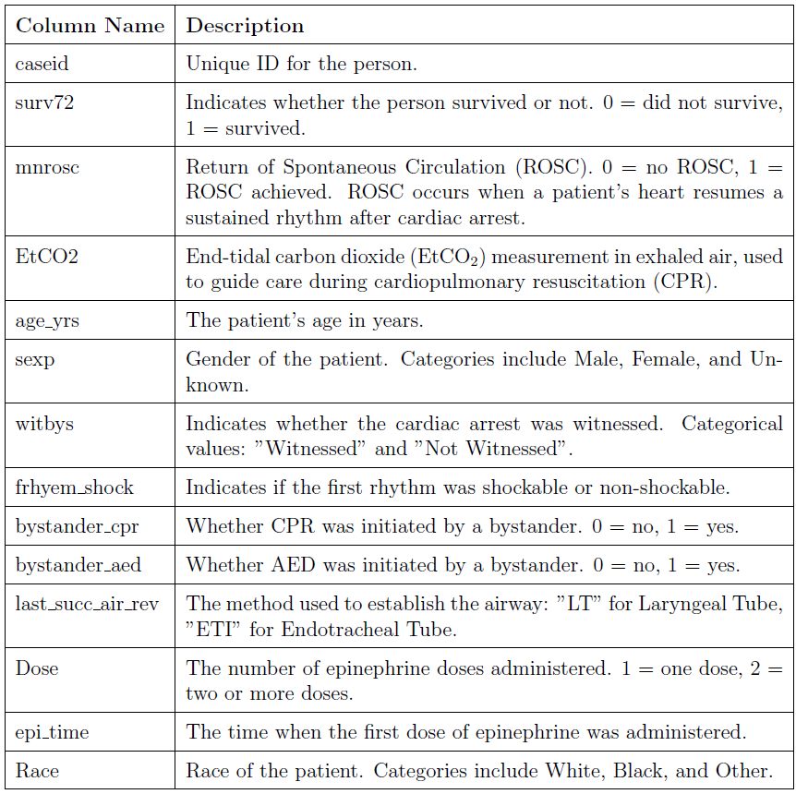
Attributes of the Dataset

Slide 7
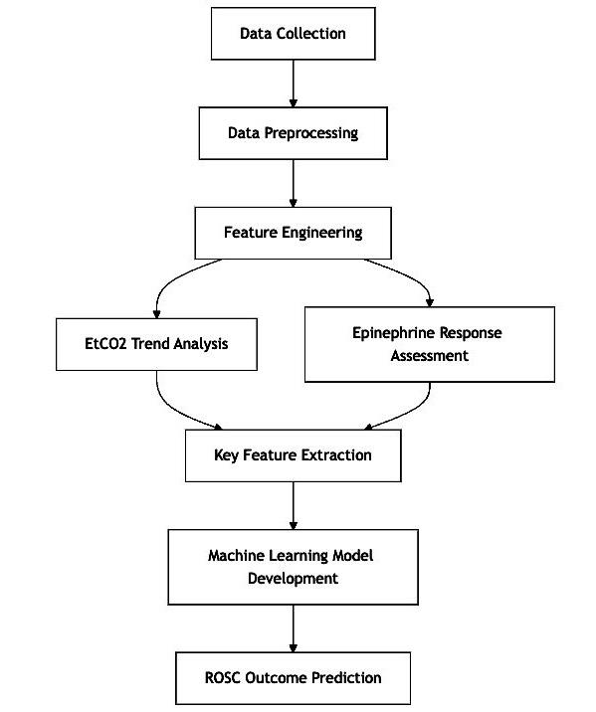
Project Pipeline
This flowchart illustrates the step-by-step process for predicting Return of Spontaneous Circulation (ROSC) using EtCO₂ trends, from data collection and preprocessing to feature extraction and machine learning model development for real-time clinical decision-making.
Notes:
Project Pipeline: EtCO₂-Based Prediction of ROSC Outcomes
Data Collection
Gathering EtCO₂ capnography waveforms from resuscitation trials and patient demographic information.
Data Preprocessing
Cleaning and organizing the data for further analysis, including missing value handling and feature encoding.
Feature Engineering
Creation of derived features from EtCO₂ data, such as slope and time to peak, to capture trends and dynamics.
EtCO₂ Trend Analysis
Analyzing temporal variations in EtCO₂ levels during CPR to identify key trends associated with ROSC.
Epinephrine Response Assessment
Evaluating the patient’s physiological response to epinephrine through key metrics (e.g., time to peak, duration of rise).
Key Feature Extraction
Selecting the most relevant features that correlate with ROSC prediction to improve model accuracy.
Machine Learning Model Development
Building and training machine learning models to predict ROSC outcomes based on extracted features.
ROSC Outcome Prediction
Using the trained models to make real-time predictions on the likelihood of ROSC for patients undergoing resuscitation.

Slide 8
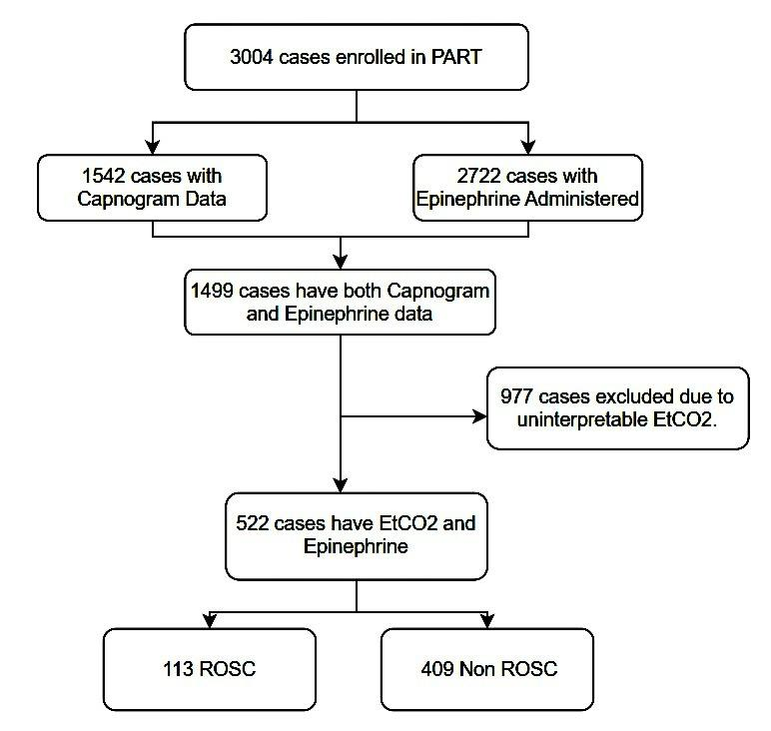
Data Preprocessing
This flowchart illustrates the data cleaning process, where all non-interpretable EtCO₂ data was removed to ensure the accuracy and consistency of the dataset, minimizing discrepancies for the analysis.
Categorical variables (sex, witnessed status, rhythm type) were encoded into numerical formats for model compatibility.
Class imbalance between ROSC and non-ROSC cases was addressed using SMOTE(Synthetic Minority Oversampling Technique) to ensure balanced and accurate predictions.
Notes:
SMOTE (Synthetic Minority Oversampling Technique) is a data augmentation technique used to address class imbalance in machine learning datasets. It works by generating synthetic samples for the minority class, thereby balancing the dataset and improving model performance for imbalanced classification tasks.
SMOTE identifies k-nearest neighbors of each data point in the minority class.It generates synthetic data points by interpolating between a data point and one of its neighbors, ensuring that the new points lie on the line segment between them.This creates realistic, diverse samples for the minority class.

Slide 9
Feature Engineering – EtCO2 Slope
EtCO2 Slope Calculation: Analyzing the change in EtCO2 over time during resuscitation to predict ROSC.
Slope Formula: ΔEtCO2 = EtCO2(t2) - EtCO2(t1), where the slope indicates the rate of change in EtCO2, calculated over time intervals, typically 1 minute.
The relationship between EtCO2 and time is modeled using linear regression (polynomial fitting of degree 1), which fits a straight line to the EtCO2 data points for each patient. The resulting slope indicates the average rate of change in EtCO2 per unit of time, providing insights into the patient’s likelihood of achieving ROSC.
Notes:
The slope is simply a way of measuring how something changes over time. In this case, we are looking at the changes in a patient's EtCO2 levels during resuscitation. By drawing a straight line through the data points, the slope tells us how quickly the EtCO2 levels are increasing or decreasing. If the slope is steep, it means EtCO2 is changing quickly, while a flat slope means the changes are happening slowly or not at all. This helps us understand if the patient's condition is improving or worsening during the process.

Slide 10
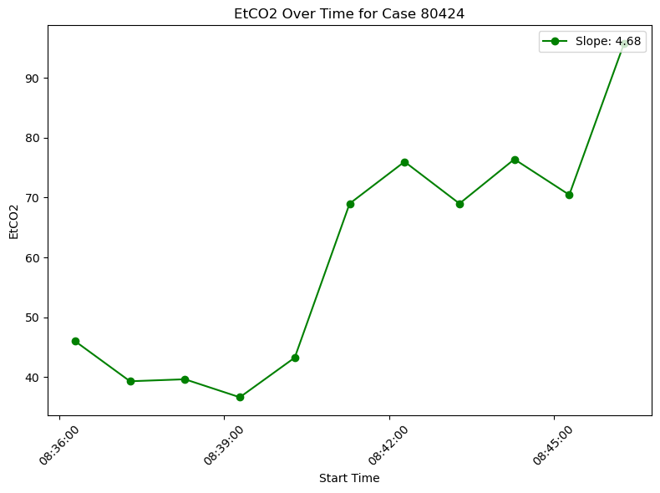
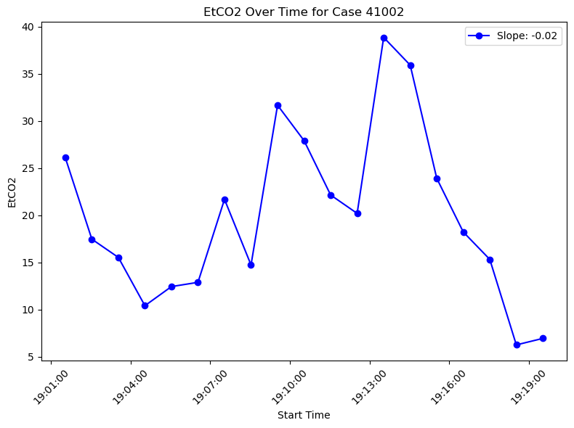
Result of Slope Calculation
The slope of EtCO2 indicates the direction of a patient's resuscitation progress, with a positive slope suggesting improvement and a negative slope indicating worsening conditions.
Notes:
Cochran Armitage test
The Cochran-Armitage test further validated
these findings, showing a significant difference in the temporal trends of EtCO2-related
features between ROSC and non-ROSC groups.

Slide 11
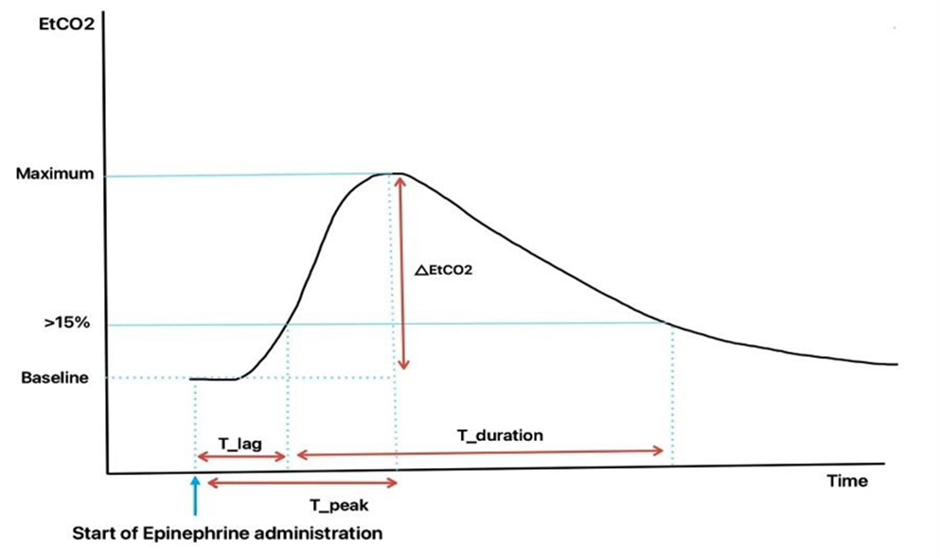
Epinephrine’s Temporal Effects on EtCO2
Following Roh et al.'s methodology, this study investigates how epinephrine affects EtCO₂ dynamics during cardiac resuscitation, analogous to their research on sodium bicarbonate's impact.
Notes:
Sobium bicarb is used to offset the high acid production, in an attempt to help the body restore normal homeostasis in cardiac arrest
Epinephrine is the primary drug administered during cardiopulmonary resuscitation (CPR) to reverse cardiac arrest. Epinephrine increases arterial blood pressure and coronary perfusion during CPR .
Findings of the study suggest that if epinephrine is used during cardiopulmonary resuscitation (CPR) it is more likely to be beneficial if given early in the resuscitation attempt.
T_lag (Time taken for the ETCO₂ value to rise above 15% of the baseline)
T_Peak(Time taken to reach maximum value of etco2 after epinephrine)
T_Duration(How long the ETCO₂ stays above 15% of the baseline after T_lag is reached)
percentage increase in ETCO₂ from the baseline to the peak value after epinephrine

Slide 12
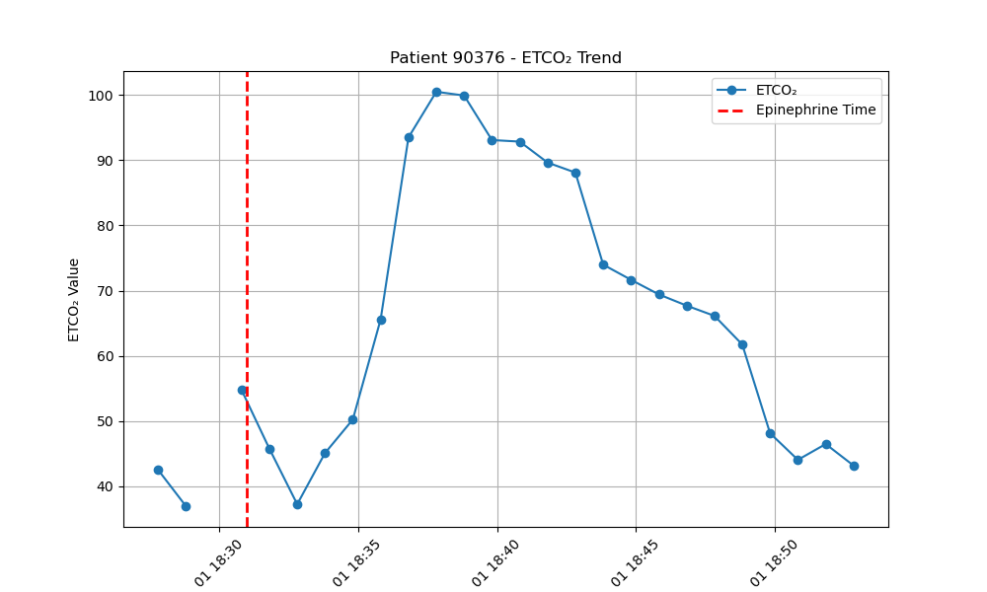
Examples of EtCO2 waveform Post Epinephrine

Slide 13
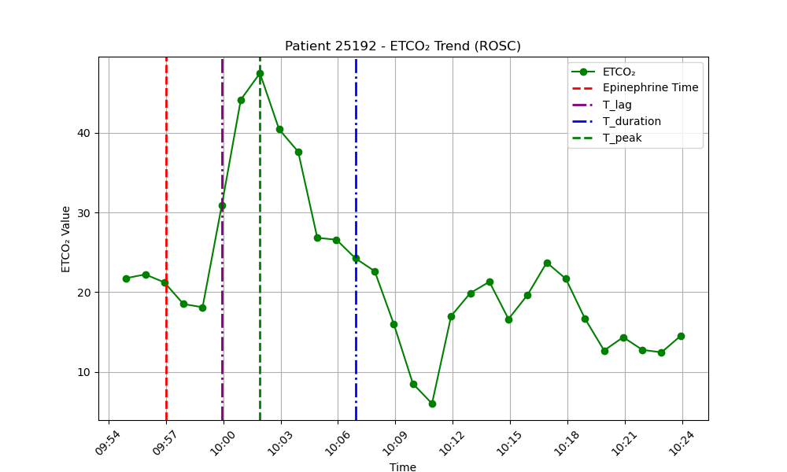
Example plot for a ROSC patient, showing the calculation of ΔEtCO2 peak, Tlag, Tpeak, and Tduration.

Slide 14
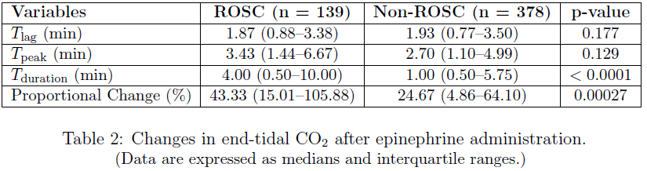



Observations
The Mann-Whitney test showed significant differences in Tduration and Proportional Change, while no significant differences were found for Tlag and Tpeak, with a p-value threshold of 0.05.
Notes:
Both groups showed a similar response in how quickly their ETCO₂ levels started to rise after the epinephrine was administered.
The time to reach peak ETCO₂ was slightly longer in the ROSC group, suggesting that peak values took more time to develop in ROSC patients.
T_dur: ROSC patients maintained elevated ETCO₂ levels for a longer period compared to Non-ROSC patients, indicating a more sustained capnography response after epinephrine in ROSC cases.
Proprtional change: The ROSC group showed a significantly greater increase in ETCO₂ levels after epinephrine compared to the Non-ROSC group, indicating a more robust capnography response in ROSC patients.

Slide 15
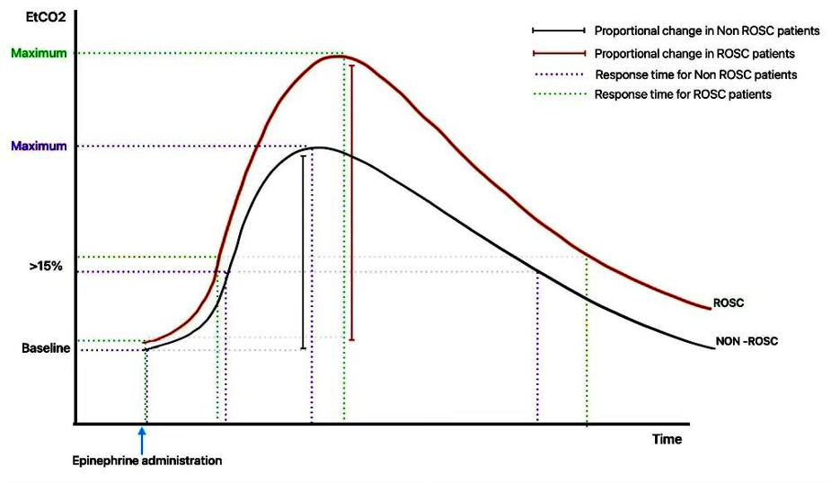
Schematic Representation of Post Epi Results for ROSC and Non ROSC group.

Slide 16
Feature Extraction
Along with the existing dataset attributes, additional features like slope, Tlag, Tpeak, Tduration, and proportional change were introduced.
Identifying important features was done using two methods:
Odds Ratio - Logistic Regression
Odds ratio is obtained by exponentiating the regression coefficient from logistic regression, with the formula OR=eβ, where β is the estimated coefficient for the predictor variable.
Feature Importance - Random Forest
Obtained by evaluating how much each feature contributes to the reduction in model error, based on the improvement in prediction accuracy when splitting the data at each feature.
Notes:
"To identify the most important features, I calculated odds ratios using logistic regression.
The odds ratio is derived by exponentiating the regression coefficient for each feature. This metric indicates the relative likelihood of an event (like ROSC) given a unit increase in the feature value.
The formula for this is OR = e^β, where β is the coefficient.“
"This method provides an interpretable way to understand how each feature contributes to predicting the outcome.“
Random forest:
I also used a Random Forest model to assess feature importance.
In this approach, we evaluate how much each feature reduces the model's error by splitting the data based on that feature.
Features that significantly improve prediction accuracy are assigned higher importance.
""Unlike logistic regression, this method captures non-linear relationships and feature interactions, giving us a more nuanced understanding of the data.

Slide 17
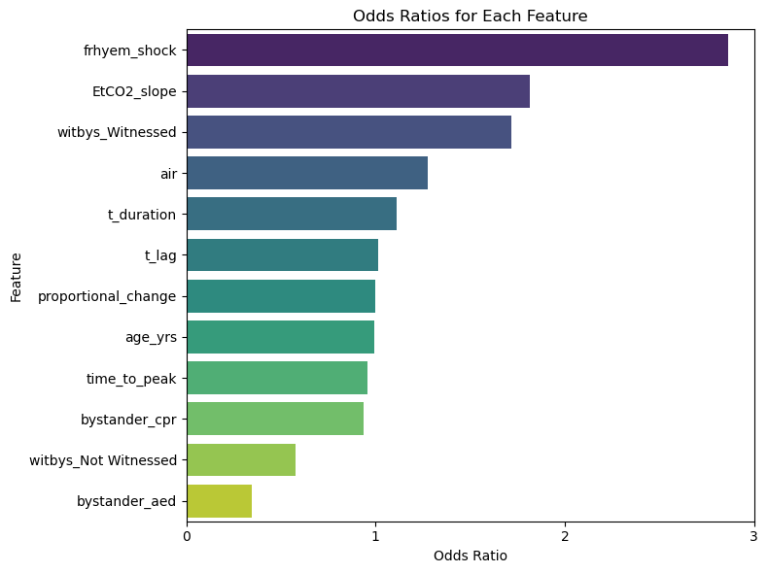
Odds Ratio
The chart illustrates that "frhyem_shock[2.8]“ and "EtCO2_slope[1.8]" are the most significant features, with higher odds ratios for predicting ROSC.
Notes:
### Slide Title: **Calculating Odds Ratio in Logistic Regression**
**PowerPoint Notes:**
- **What is Odds Ratio (OR)?**
- The **odds ratio** (OR) is a measure of association between a predictor (independent variable) and an outcome (dependent variable). It represents how the odds of the outcome change with a one-unit change in the predictor.
- **OR > 1**: The predictor increases the odds of the outcome.
- **OR < 1**: The predictor decreases the odds of the outcome.
- **OR = 1**: No effect.
- **Formula for Odds Ratio:**
\[
\text{Odds Ratio} = \frac{\text{Odds of outcome for category 1}}{\text{Odds of outcome for category 0}}
\]
- **Odds** = \(\frac{\text{Probability of event occurring}}{\text{Probability of event not occurring}}\)
- **How is OR Calculated in Logistic Regression?**
- Logistic regression estimates the relationship between a dependent variable and one or more independent variables using the **log-odds**.
- The coefficients (\( \beta \)) estimated by logistic regression are **log-odds**, and **Odds Ratio** is calculated by exponentiating these coefficients:
\[
\text{OR} = e^{\beta}
\]
Where:
- **\( \beta \)** is the coefficient for a given predictor in the logistic regression model.
- **\( e \)** is the mathematical constant approximately equal to 2.71828.
- **Interpretation of OR**:
- **OR > 1**: An increase in the predictor increases the odds of the outcome occurring.
- **OR < 1**: An increase in the predictor decreases the odds of the outcome occurring.
- **OR = 1**: The predictor has no effect on the odds of the outcome.
- **Example in Practice**:
- Suppose you are studying the relationship between smoking (yes/no) and lung cancer (yes/no).
- The logistic regression might give a coefficient of 1.5 for smoking. To calculate the OR:
\[
\text{OR} = e^{1.5} \approx 4.48
\]
- This means that the odds of lung cancer are 4.48 times higher for smokers than for non-smokers.
- **Why Use Odds Ratio?**
- **Interpretability**: Odds ratios provide a clear and easy-to-interpret measure of association between predictors and outcomes.
- **Handling categorical variables**: OR is particularly useful for binary categorical outcomes like success/failure or presence/absence.
**Summary**:
- Odds ratios are calculated by exponentiating the coefficients from logistic regression models. An OR greater than 1 indicates that the predictor increases the odds of the outcome, while an OR less than 1 indicates a decrease.

Slide 18
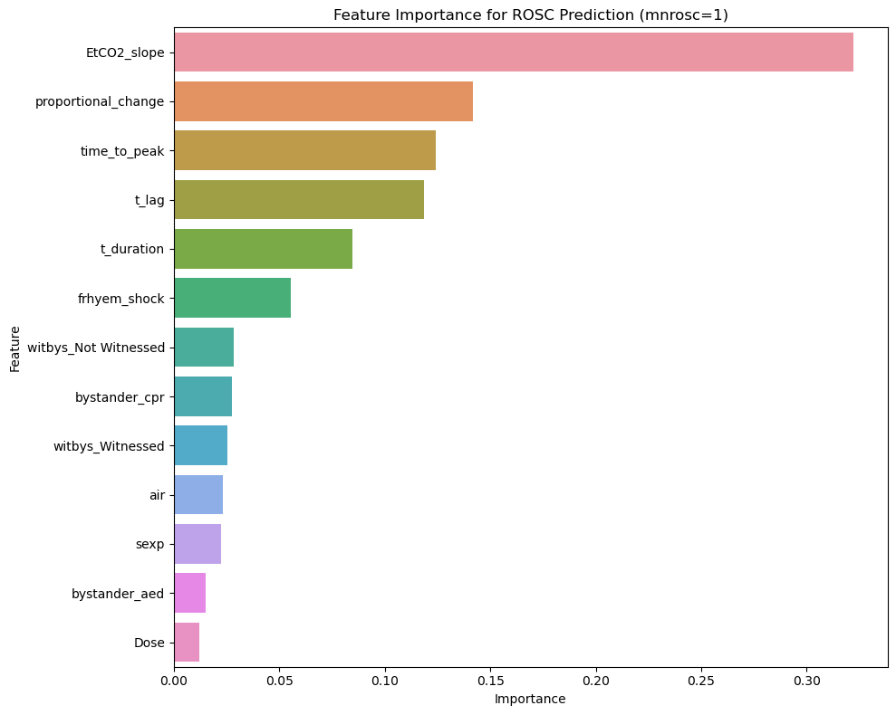
Feature Importance
The first five features are all derived from EtCO2 values, emphasizing the significance of EtCO2 dynamics in predicting resuscitation outcomes, while the sixth feature, "fryhem_shock," pertains to the initial rhythm type.
These results align with the findings from the odds ratio analysis.
Notes:
Random Forest Overview: Random Forest builds multiple decision trees using different subsets of data and features. It aggregates predictions from each tree to make final decisions.
Gini Impurity/Entropy: Each decision tree split is made based on features that minimize impurity (Gini or Entropy), aiming to make data "pure" at each node. Features that result in better splits are considered more important.
Feature Contribution: Feature importance is determined by how much each feature improves prediction accuracy across all trees in the forest. Features that significantly improve predictions are ranked as more important.
Permutation Importance: After training, feature values are randomly shuffled, and model performance is evaluated. A large drop in performance indicates that the feature is important.
Final Ranking: Features with the highest importance are those that most impact the model’s accuracy. The Random Forest model ranks features based on their ability to reduce error and improve prediction accuracy.
Summary: Random Forest uses decision tree splits and performance metrics (Gini/Entropy, Permutation Importance) to determine and rank feature importance, giving higher importance to features that lead to better model performance.

Slide 19
Predictive Modelling for ROSC/Non ROSC
Model Selection:
Logistic Regression: A linear model trained with balanced class weights for comparison.
Random Forest Classifier: Trained using the preprocessed data, capturing complex, non-linear relationships.
Model Training:
The models were trained using the processed dataset, ensuring the inclusion of features like EtCO2 Slope, Tpeak, Proportional Change, and other temporal EtCO2 metrics.
Model Evaluation:
Performance was measured using accuracy, precision, recall, F1-score, and AUC-ROC.
The ROC curve was plotted for comparison between Random Forest and Logistic Regression.
Notes:
Model Building for Predicting ROSC
Methodology To predict Return of Spontaneous Circulation (ROSC), the model building process utilized features extracted from the EtCO₂ dynamics observed during resuscitation. The data underwent several preprocessing steps, including encoding categorical variables, handling missing values, and balancing classes with SMOTE due to the imbalance between ROSC and non-ROSC cases. Two machine learning models were then trained for prediction: Random Forest Classifier and Logistic Regression.
Data Preprocessing:
Categorical features, including frhyem_shock and witbys, were encoded using one-hot encoding.
Duplicates and irrelevant columns were removed, and any remaining missing values were filled with zeros.
SMOTE was applied to the data to address class imbalance, ensuring equal representation of ROSC and non-ROSC cases in the training set.
Model Training:
Random Forest Classifier: This model, known for its ability to capture complex, non-linear patterns, was trained using the balanced data. It was configured with default settings, leveraging its ensemble approach to increase robustness and accuracy.
Logistic Regression: Logistic regression, with balanced class weights to account for the original imbalance, was trained as a baseline linear model to assess feature significance through odds ratios.
Evaluation Metrics: The models were evaluated on accuracy, precision, recall, F1-score, and AUC-ROC score. Confusion matrices were also generated to visualize true positive and false positive rates. The ROC curve was plotted to illustrate the models’ performances across varying thresholds.

Slide 20
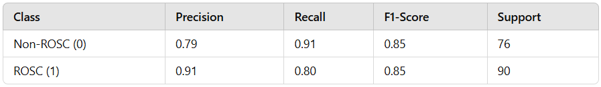
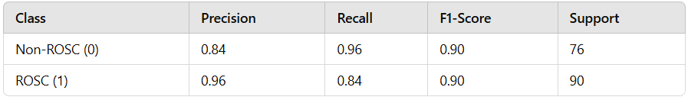
Classification Report
Logistic Regression [ Accuracy: 85]
Random Forest Classifier [ Accuracy: 90]
Notes:
Accuracy is the proportion of correctly classified instances (both true positives and true negatives) out of all instances. Accuracy gives an overall measure of how often the model makes the correct prediction.
Random Forest Classification Report: The Random Forest model achieved an overall accuracy of 90%, with precision and recall scores of 0.84 for non-ROSC and 0.96 for ROSC cases. This high accuracy and balanced metrics demonstrate its strong predictive power in distinguishing between ROSC and non-ROSC cases.
Logistic Regression Classification Report: Logistic regression achieved an accuracy of 85%, with slightly lower precision and recall scores compared to the Random Forest model. The model's precision and recall for ROSC were 0.91 and 0.80, respectively, indicating its effectiveness in identifying ROSC cases but with slightly higher false positives than the Random Forest.
Confusion Matrix: The model correctly identified 69 non-ROSC cases and 72 ROSC cases, with a total of 25 misclassifications (7 false positives and 18 false negatives).

Slide 21
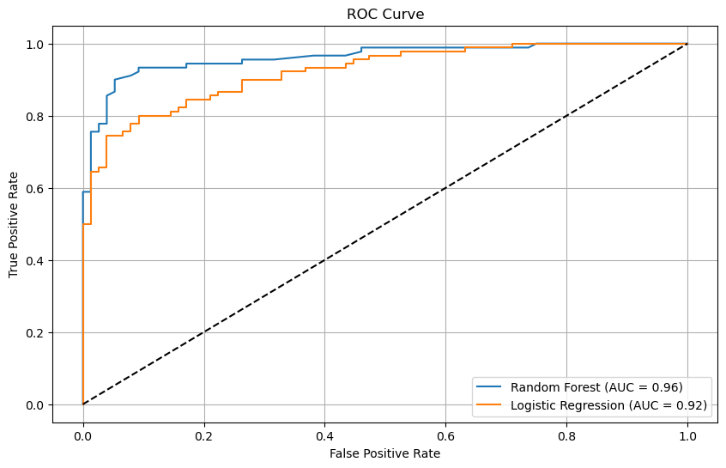
Results
Notes:
Definition: AUC refers to the area under the Receiver Operating Characteristic (ROC) curve, which plots the True Positive Rate (TPR, or sensitivity) against the False Positive Rate (FPR, or 1-specificity). AUC measures the ability of the model to distinguish between the positive and negative classes across all possible classification thresholds.
AUC ranges from 0 to 1:
AUC = 1 indicates a perfect model.
AUC = 0.5 indicates a model with no discriminative power (similar to random guessing).
AUC > 0.7 typically indicates a good model.
Indicates: AUC is particularly useful for imbalanced datasets. Unlike accuracy, which can be skewed by the majority class, AUC provides a more balanced view of the model's performance, assessing how well the model distinguishes between classes regardless of class distribution.
ROC Curve and AUC Analysis The ROC curve (attached above) highlights the performance of both models. The Random Forest model achieved an AUC score of 0.96, outperforming the Logistic Regression model, which had an AUC of 0.92. This result indicates that the Random Forest model provides better discrimination between ROSC and non-ROSC cases across various thresholds.
Final Conclusion
In summary, both models demonstrated predictive capabilities for ROSC using the engineered EtCO₂ features. However, the Random Forest model outperformed Logistic Regression in accuracy and AUC score, indicating a stronger ability to capture complex interactions within the data. The insights gained from the Random Forest model, particularly regarding features like EtCO₂ Slope and T_peak, suggest that these temporal changes in EtCO₂ could serve as reliable indicators in clinical decision-making. This model could potentially aid clinicians by providing a robust tool for predicting resuscitation outcomes, helping to guide timely and appropriate interventions during resuscitation efforts.

Slide 22
Flask Application for Cardiac Arrest Data Processing
Key Features:
Standardized Data Extraction: Harmonizes data from multiple organizations (e.g., Columbus Fire Department, Peel Data Center) into a consistent format.
Customized Filtering: Enables targeted analysis by selecting specific clinical interventions (e.g., epinephrine, defibrillation).
Data Integration: Consolidates disparate datasets into a unified structure with unique identifiers for each patient.
Code and Access: The complete code and live application are deployed at banupr15.pythonanywhere.com/ ensuring efficient data preparation for the study on EtCO2-guided resuscitation.
Notes:
Explain how data looked initially and how it was organized.

Slide 23
Limitations & Conclusion
The dataset, collected between 2015 and 2017, may not fully reflect current medical practices or advancements in technology.
The study only examined the first dose of epinephrine, missing potential variations in response to multiple doses.
EtCO2 dynamics, especially the slope and proportional change, effectively predict ROSC and can guide clinical decisions during resuscitation.
The Flask-based tool facilitates the efficient processing of medical data, enhancing real-time decision-making and future research applications.

Slide 24

Thank You

Slide 25
References
Terms
https://www.jems.com/patient-care/airway-respiratory/how-to-read-and-interpret-end-tidal-capnography-waveforms/
AI processing
https://ohiostate.elsevierpure.com/en/publications/artificial-intelligence-for-end-tidal-capnography-guided-resuscit
Sodium
https://www.sciencedirect.com/science/article/pii/S0735675723006393#:~:text=Conclusions-,The%20administration%20of%20sodium%20bicarbonate%20may%20lead%20to%20a%20substantial,or%20cardiac%20arrest%20receiving%20CPR.
Epinephrine
https://jamanetwork.com/journals/jamanetworkopen/fullarticle/2782848

